Slide 1
UPPER SIXTH ARTS
GEOGRAPHY
Lesson 6
Age and Sex Composition
Notes:
Good morning, class, and welcome to our geography lesson. I am your geography teacher, Mr Kamdem. Today we are starting Lesson 6: Age and Sex Composition.

Slide 2
CLASS INFO
Class, Chapter and Duration
Class | Upper Sixth Arts
Chapter | Module 4: Understanding and managing population dynamics across the world in general and Cameroon in particular
Duration | 2 periods (2 × 50 minutes)
Notes:
This lesson is for Upper Sixth Arts. It belongs to Module 4: Understanding and managing population dynamics across the world in general and Cameroon in particular. We shall need 2 periods to cover it.

Slide 3
IDENTIFICATION
Lesson Identification
Topic | Population Structure and Composition
Sub-topic | Age-Sex Composition
Lesson | Lesson 6: Age and Sex Composition
Notions / Concepts | Age structure, sex composition, sex ratio, youthful population, ageing population, population momentum, dependency.
Syllabus focus | Meaning of age and sex composition; global patterns: youthful and ageing populations with examples; socio-economic consequences of each.
Competence | Learners are able to distinguish youthful and ageing populations and explain their socio-economic consequences and planning challenges.
Notes:
Our topic is Population Structure and Composition, and the sub-topic is Age-Sex Composition. The key notions we shall use today are: age structure, sex composition, sex ratio, youthful population, ageing population, population momentum, dependency. At the end, you should be able to do this: learners are able to distinguish youthful and ageing populations and explain their socio-economic consequences and planning challenges.

Slide 4

HOMEWORK CORRECTION
Correction of the Homework
Question (Lesson 5: Population Structure):
Define the sex ratio.
Notes:
Before we start the new lesson, let us correct the homework I gave you at the end of Lesson 5: Population Structure. The question was: Define the sex ratio. Take out your exercise books.

Slide 5
HOMEWORK CORRECTION
Correction: Possible Answer
The sex ratio is the number of males for every 100 females in a population.
Notes:
Here is a good answer. The sex ratio is the number of males for every 100 females in a population. Compare it with your own answer and correct your work in red.

Slide 6
LESSON PLAN
Lesson Plan
Correction of the homework
Objectives and recall
Real-life situation and action to take
Learning activities
Board summary
Evaluation, remediation and homework
Notes:
Here is the plan of our lesson today. First, we shall correct the homework. Then we shall look at the objectives and recall what you already know. After that, we shall study a situation from real life and the action to take, and do the learning activities. Finally, we shall copy the board summary, do the evaluation and the remediation, and I will give you the homework.

Slide 7
OBJECTIVES
Objectives
By the end of this lesson, you should be able to:
Define age composition, sex composition and sex ratio.
Explain the factors of the sex ratio.
Notes:
Take your time to copy this part; we will continue together.

Slide 8
OBJECTIVES
Objectives (continued)
Describe a youthful population and its consequences.
Describe an ageing population and its consequences.
Notes:
By the end of this lesson, you should be able to do four things. Number 1: define age composition, sex composition and sex ratio. Number 2: explain the factors of the sex ratio. Number 3: describe a youthful population and its consequences. Number 4: describe an ageing population and its consequences.

Slide 9
PREVIOUS KNOWLEDGE
Previous Knowledge
The three age groups are 0–14, 15–64 and 65 and over.
The sex ratio is the number of males per 100 females.
Cameroon has many children.
Notes:
Let us first remember what you already know. The three age groups are 0–14, 15–64 and 65 and over. The sex ratio is the number of males per 100 females. Cameroon has many children. Keep this in mind, because we shall build on it today.

Slide 10
REAL-LIFE SITUATION
Situation in Real Life
At the Garoua Regional Hospital, the maternity and paediatric wards are full of pregnant women and hundreds of children, while the ward for elderly people is small.
In the universities and training centres of the North, most students are between 18 and 30 years old.
Notes:
Take your time to copy this part; we will continue together.

Slide 11
REAL-LIFE SITUATION
Situation in Real Life (continued)
A visiting doctor from Japan says that in his country hospitals are full of old people and many schools close.
A student asks: "Why is our population so young while Japan's is so old, and what problems does each situation cause?"
Notes:
Listen carefully to this situation from real life. At the Garoua Regional Hospital, the maternity and paediatric wards are full of pregnant women and hundreds of children, while the ward for elderly people is small. In the universities and training centres of the North, most students are between 18 and 30 years old. A visiting doctor from Japan says that in his country hospitals are full of old people and many schools close. A student asks: "Why is our population so young while Japan's is so old, and what problems does each situation cause?" Think about it, because I am going to ask you some questions.

Slide 12
REAL-LIFE SITUATION
Situation: Question 1
What is the problem in the situation?
Notes:
Question 1: What is the problem in the situation? Think for a moment, then raise your hand to answer.

Slide 13
REAL-LIFE SITUATION
Answer
The student does not understand the difference between youthful and ageing populations and their consequences.
Notes:
Good. The student does not understand the difference between youthful and ageing populations and their consequences.

Slide 14
REAL-LIFE SITUATION
Situation: Question 2
Why are there so many children in Garoua?
Notes:
Question 2: Why are there so many children in Garoua? Think for a moment, then raise your hand to answer.

Slide 15
REAL-LIFE SITUATION
Answer
Because birth rates are high and life expectancy is lower than in developed countries.
Notes:
Good. Because birth rates are high and life expectancy is lower than in developed countries.

Slide 16
REAL-LIFE SITUATION
Situation: Question 3
What is the main challenge of a youthful population?
Notes:
Question 3: What is the main challenge of a youthful population? Think for a moment, then raise your hand to answer.

Slide 17
REAL-LIFE SITUATION
Possible Answer
Creating enough schools and jobs for the many young people.
Notes:
Good. Creating enough schools and jobs for the many young people.

Slide 18
ACTION TO TAKE
Action to Take
Prepare for the job market through studies and training, and respect and care for elderly people.
Notes:
From this situation, the action we are working towards in this lesson is the following: prepare for the job market through studies and training, and respect and care for elderly people.

Slide 19
JUSTIFICATION
Justification of the Lesson
This lesson helps us to understand the problems caused by a young or an old population and the policies needed.
Notes:
Why is this lesson important for you? This lesson helps us to understand the problems caused by a young or an old population and the policies needed.

Slide 20
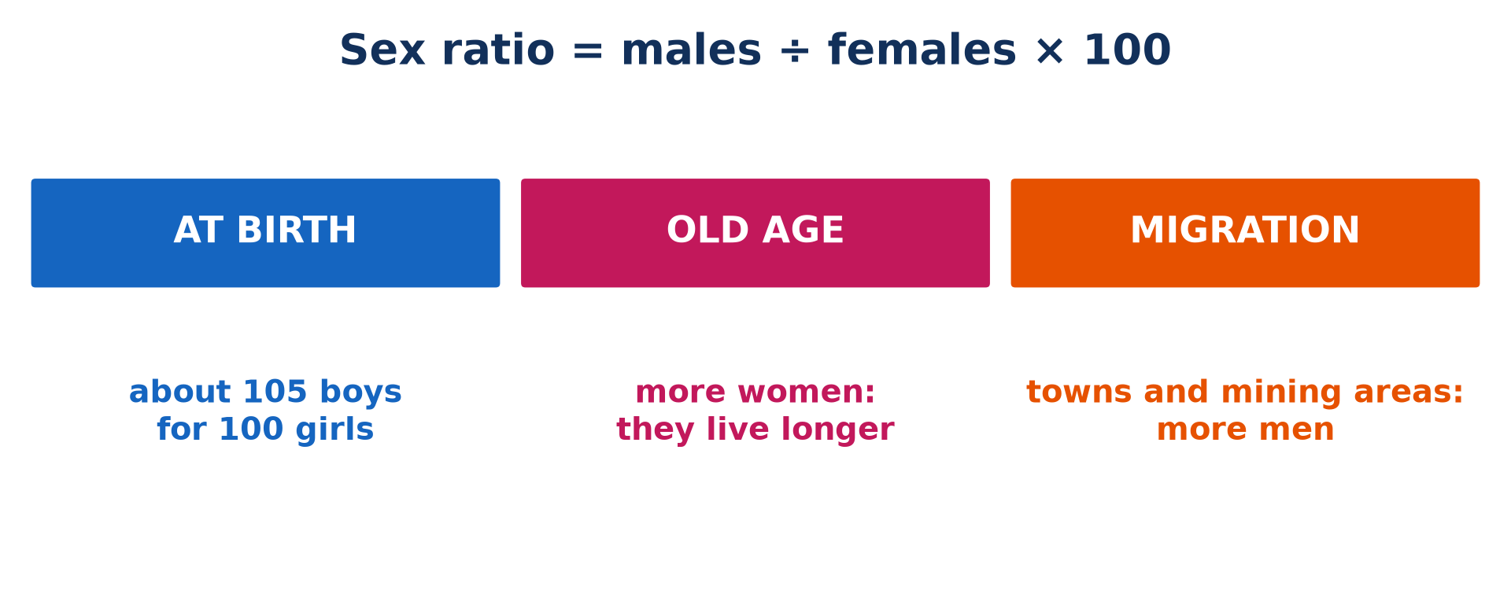
1. SEX COMPOSITION
Activity 1
The sex ratio.
Notes:
Activity 1. Look carefully at this picture: the sex ratio. Observe every detail before I ask the question.

Slide 21
1. SEX COMPOSITION
Activity 1: Question
Why are there more women than men among old people?
Notes:
Here is the question for Activity 1: Why are there more women than men among old people? Take one minute to think and write your answer in your rough notebook.

Slide 22
1. SEX COMPOSITION
Activity 1: Answer
Women generally live longer than men.
Notes:
Let us check the answer together. Women generally live longer than men.

Slide 23
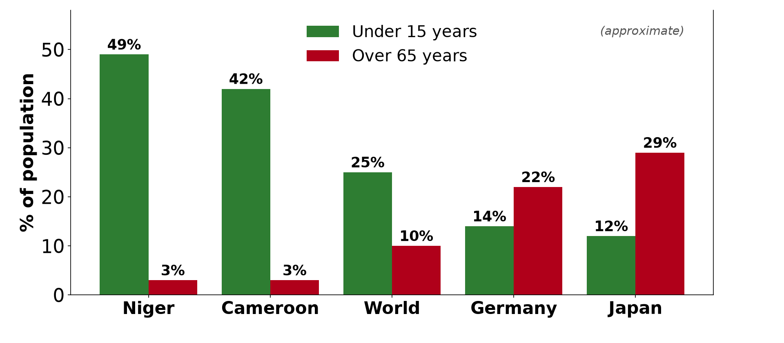
2. YOUTHFUL POPULATION
Activity 2
Young and old people in some countries.
Notes:
Activity 2. Look carefully at this diagram: young and old people in some countries. Observe every detail before I ask the question.

Slide 24
2. YOUTHFUL POPULATION
Activity 2: Question
About what share of the population of Cameroon is under 15?
Notes:
Here is the question for Activity 2: About what share of the population of Cameroon is under 15? Take one minute to think and write your answer in your rough notebook.

Slide 25
2. YOUTHFUL POPULATION
Activity 2: Answer
About 42 %.
Notes:
Let us check the answer together. About 42 %.

Slide 26

2. YOUTHFUL POPULATION
Activity 3
A crowded classroom.
Notes:
Activity 3. Look carefully at this picture: a crowded classroom. Observe every detail before I ask the question.

Slide 27
2. YOUTHFUL POPULATION
Activity 3: Question
Give one consequence of a youthful population.
Notes:
Here is the question for Activity 3: Give one consequence of a youthful population. Take one minute to think and write your answer in your rough notebook.

Slide 28
2. YOUTHFUL POPULATION
Activity 3: Answer
Crowded schools, high unemployment or a high dependency ratio.
Notes:
Let us check the answer together. Crowded schools, high unemployment or a high dependency ratio.

Slide 29

3. AGEING POPULATION
Activity 4
The pyramid of Japan.
Notes:
Activity 4. Look carefully at this diagram: the pyramid of Japan. Observe every detail before I ask the question.

Slide 30
3. AGEING POPULATION
Activity 4: Question
Why is the base of the pyramid of Japan narrow?
Notes:
Here is the question for Activity 4: Why is the base of the pyramid of Japan narrow? Take one minute to think and write your answer in your rough notebook.

Slide 31
3. AGEING POPULATION
Activity 4: Answer
Because birth rates are very low.
Notes:
Let us check the answer together. Because birth rates are very low.

Slide 32

3. AGEING POPULATION
Activity 5
A doctor at work.
Notes:
Activity 5. Look carefully at this picture: a doctor at work. Observe every detail before I ask the question.

Slide 33
3. AGEING POPULATION
Activity 5: Question
Give one consequence of an ageing population.
Notes:
Here is the question for Activity 5: Give one consequence of an ageing population. Take one minute to think and write your answer in your rough notebook.

Slide 34
3. AGEING POPULATION
Activity 5: Answer
High spending on pensions and health care, or a shortage of workers.
Notes:
Let us check the answer together. High spending on pensions and health care, or a shortage of workers.

Slide 35
BOARD SUMMARY
Board Summary
Topic: Population Structure and Composition
Sub-topic: Age-Sex Composition
Lesson 6: Age and Sex Composition
Notes:
Now we are going to copy the board summary. Write the title and the headings neatly in your notebooks. I will give you enough time for each slide, so do not rush.

Slide 36
BOARD SUMMARY
DEFINITIONS
The key terms of this lesson are defined as follows:
Age composition: It is the division of a population into age groups.
Sex ratio: It is the number of males for every 100 females.
Notes:
Let us copy the definitions. The key terms of this lesson are defined as follows. On this slide we have Age composition and Sex ratio. Write each point on a new line, with the key term first, and explain it in your own words when we revise. When you finish, we go to the next slide.

Slide 37
BOARD SUMMARY
DEFINITIONS (continued)
Youthful population: It is a population with a high share of young people (over 40 % under 15) and few old people.
Ageing population: It is a population with a high share of old people (over 15 % aged 65 and over) and few children.
Notes:
We continue with the definitions. On this slide we have Youthful population and Ageing population. Write each point on a new line, with the key term first, and explain it in your own words when we revise.

Slide 38
BOARD SUMMARY
1. Meaning of Age and Sex Composition
A) Age Groups and Sex Ratio
Age and sex composition is explained as follows:
Age groups: The population is divided into young dependants (0 to 14 years), the working population (15 to 64 years) and old dependants (65 years and over). This division shows the past of a population and helps to predict its future needs.
Notes:
Let us copy Age Groups and Sex Ratio. Age and sex composition is explained as follows. Copy the point on Age groups: write the key term first, then its explanation.

Slide 39
BOARD SUMMARY
1. Meaning of Age and Sex Composition
A) Age Groups and Sex Ratio
The sex ratio: It is calculated as males ÷ females × 100. A ratio above 100 means more men than women, and a ratio below 100 means more women than men.
Illustration: the sex ratio
Notes:
Copy the point on The sex ratio on the left, then draw the diagram on the right: the sex ratio. Give it a title and label it clearly.

Slide 40
BOARD SUMMARY
1. Meaning of Age and Sex Composition
B) Factors of the Sex Ratio
The sex ratio varies because of the following factors:
More boys at birth: About 105 boys are born for every 100 girls. The sex ratio of young children is therefore slightly above 100.
Notes:
Let us copy Factors of the Sex Ratio. The sex ratio varies because of the following factors. Copy the point on More boys at birth: write the key term first, then its explanation.

Slide 41
BOARD SUMMARY
1. Meaning of Age and Sex Composition
B) Factors of the Sex Ratio
More women in old age: Women live longer than men on average. Old age groups therefore contain more women than men.
Notes:
We continue with Factors of the Sex Ratio. Copy the point on More women in old age: write the key term first, then its explanation.

Slide 42
BOARD SUMMARY
1. Meaning of Age and Sex Composition
B) Factors of the Sex Ratio
More men in towns and mining areas: Men migrate more for work, so towns and mining areas have more men than women. Wars kill more men, which lowers the sex ratio of the adult population.
Notes:
We continue with Factors of the Sex Ratio. Copy the point on More men in towns and mining areas: write the key term first, then its explanation.

Slide 43
BOARD SUMMARY
2. Global Patterns
A) The Youthful Population
The youthful population has the following characteristics:
Many young people: More than 40 % of the people are under 15 years old. This is because birth rates are high.
Illustration: youthful and ageing populations
Notes:
Let us copy The Youthful Population. The youthful population has the following characteristics. Copy the point on Many young people on the left, then draw the diagram on the right: youthful and ageing populations. Give it a title and label it clearly.

Slide 44
BOARD SUMMARY
2. Global Patterns
A) The Youthful Population
Few old people: Fewer than 5 % of the people are 65 or over. Life expectancy is still low because of poverty and diseases.
Notes:
We continue with The Youthful Population. Copy the point on Few old people: write the key term first, then its explanation.

Slide 45
BOARD SUMMARY
2. Global Patterns
A) The Youthful Population
Location: Youthful populations are found in developing countries, such as Niger, Nigeria and the DR Congo. Most of them are in sub-Saharan Africa.
Notes:
We continue with The Youthful Population. Copy the point on Location: write the key term first, then its explanation.

Slide 46

BOARD SUMMARY
2. Global Patterns
A) The Youthful Population
Example of Cameroon: About 42 % of Cameroonians are under 15 and only about 3 % are 65 or over. Cameroon therefore has a youthful population.
Illustration: the pyramid of Cameroon
Notes:
Copy the point on Example of Cameroon on the left, then draw the diagram on the right: the pyramid of Cameroon. Give it a title and label it clearly.

Slide 47
BOARD SUMMARY
2. Global Patterns
B) Consequences of a Youthful Population
A youthful population has the following socio-economic consequences:
High dependency: Few workers must support many children. As a result, families and the state save and invest little.
Notes:
Let us copy Consequences of a Youthful Population. A youthful population has the following socio-economic consequences. Copy the point on High dependency: write the key term first, then its explanation.

Slide 48
BOARD SUMMARY
2. Global Patterns
B) Consequences of a Youthful Population
Pressure on services: There is a huge demand for schools, maternity wards and basic health care. Classrooms are overcrowded, as in many schools of Garoua.
Illustration: a classroom
Notes:
Copy the point on Pressure on services on the left, then draw the diagram on the right: a classroom. Give it a title and label it clearly.

Slide 49
BOARD SUMMARY
2. Global Patterns
B) Consequences of a Youthful Population
Unemployment: Many young people enter the job market each year, but jobs are too few. This causes unemployment and may lead to social unrest.
Notes:
We continue with Consequences of a Youthful Population. Copy the point on Unemployment: write the key term first, then its explanation.

Slide 50
BOARD SUMMARY
2. Global Patterns
B) Consequences of a Youthful Population
A future labour force: The many young people will soon have children, so the population will keep growing fast. If they are educated and employed, they can become a large workforce that boosts growth.
Notes:
We continue with Consequences of a Youthful Population. Copy the point on A future labour force: write the key term first, then its explanation.

Slide 51
BOARD SUMMARY
2. Global Patterns
C) The Ageing Population
The ageing population has the following characteristics:
Many old people: More than 15 % of the people are 65 or over. This is because people live longer thanks to good health care.
Illustration: the pyramid of Japan
Notes:
Let us copy The Ageing Population. The ageing population has the following characteristics. Copy the point on Many old people on the left, then draw the diagram on the right: the pyramid of Japan. Give it a title and label it clearly.

Slide 52
BOARD SUMMARY
2. Global Patterns
C) The Ageing Population
Few young people: Fewer than 20 % of the people are under 15. Birth rates are low because couples choose small families.
Notes:
We continue with The Ageing Population. Copy the point on Few young people: write the key term first, then its explanation.

Slide 53
BOARD SUMMARY
2. Global Patterns
C) The Ageing Population
Location: Ageing populations are found in developed countries, such as Japan, Germany and Italy. Most of Europe is in this situation.
Notes:
We continue with The Ageing Population. Copy the point on Location: write the key term first, then its explanation.

Slide 54
BOARD SUMMARY
2. Global Patterns
C) The Ageing Population
Example of Japan: About 29 % of Japanese are 65 or over, one of the highest shares in the world. Its population has been falling since about 2010.
Notes:
We continue with The Ageing Population. Copy the point on Example of Japan: write the key term first, then its explanation.

Slide 55
BOARD SUMMARY
2. Global Patterns
D) Consequences of an Ageing Population
An ageing population has the following socio-economic consequences:
A shrinking workforce: There are fewer young people to replace the workers who retire. Labour shortages appear, which lowers production.
Notes:
Let us copy Consequences of an Ageing Population. An ageing population has the following socio-economic consequences. Copy the point on A shrinking workforce: write the key term first, then its explanation.

Slide 56
BOARD SUMMARY
2. Global Patterns
D) Consequences of an Ageing Population
High state spending: Governments spend a lot on pensions, hospitals and care for the elderly. Fewer workers must pay taxes to support them.
Illustration: health care
Notes:
Copy the point on High state spending on the left, then draw the diagram on the right: health care. Give it a title and label it clearly.

Slide 57
BOARD SUMMARY
2. Global Patterns
D) Consequences of an Ageing Population
Closure of services: Schools and maternity wards close because there are fewer children. Some villages lose their young people and die out.
Notes:
We continue with Consequences of an Ageing Population. Copy the point on Closure of services: write the key term first, then its explanation.

Slide 58
BOARD SUMMARY
2. Global Patterns
D) Consequences of an Ageing Population
Government responses: Governments raise the retirement age and encourage births with family allowances. They also accept immigrant workers to fill labour shortages.
Notes:
We continue with Consequences of an Ageing Population. Copy the point on Government responses: write the key term first, then its explanation.

Slide 59
FORMATIVE EVALUATION
Evaluation 1
Give two characteristics of a youthful population.
Notes:
Now let us check what you have understood. Question 1: Give two characteristics of a youthful population. Answer in your exercise book.

Slide 60
FORMATIVE EVALUATION
Expected Answer
Over 40 % of people under 15 and fewer than 5 % aged 65 or over; high birth rates.
Notes:
The expected answer is: over 40 % of people under 15 and fewer than 5 % aged 65 or over; high birth rates. If you got it right, well done.

Slide 61
FORMATIVE EVALUATION
Evaluation 2
Give two consequences of an ageing population.
Notes:
Now let us check what you have understood. Question 2: Give two consequences of an ageing population. Answer in your exercise book.

Slide 62
FORMATIVE EVALUATION
Expected Answer
Labour shortages and high spending on pensions and health care (also school closures).
Notes:
The expected answer is: labour shortages and high spending on pensions and health care (also school closures). If you got it right, well done.

Slide 63
REMEDIATION
Remediation
Fill in the blanks:
The number of males per 100 females is the ______.
A population with over 40 % under 15 is ______.
Japan has an ______ population.
Notes:
For those who need more practice, fill in the blanks in your exercise book. The answers are: number 1, sex ratio; number 2, youthful; number 3, ageing.

Slide 64
HOMEWORK
Homework
State what the base of a population pyramid represents.
Notes:
For your homework: State what the base of a population pyramid represents. We shall correct it at the beginning of our next lesson.

Slide 65
NEXT LESSON
Next Lesson
Our next lesson will be on:
Lesson 7: Population Pyramids
Notes:
Our next lesson will be on Lesson 7: Population Pyramids. Thank you for your attention, and see you next time.

Slide 66
BILINGUAL GAME
Bilingual Game (Jeu Bilingue)
English | Français
Youthful population | La population jeune
Ageing population | Le vieillissement de la population
Sex ratio | Le rapport de masculinité
Dependency ratio | Le taux de dépendance
Population momentum | L'élan démographique
Retirement | La retraite
Notes:
Let us play the bilingual game. I say a word in English, and you give me the French word. Then we do the reverse.

Slide 67
LOGBOOK
Official Logbook (1/2)
Module / Topic | Population Structure and Composition
Lesson Title | Lesson 6: Age and Sex Composition
Expected Learning Outcomes | Define age composition, sex composition and sex ratio. Explain the factors of the sex ratio. Describe a youthful population and its consequences. Describe an ageing population and its consequences.
Competence | Learners are able to distinguish youthful and ageing populations and explain their socio-economic consequences and planning challenges.
Notes:
I record this information in the official logbook of the class after the lesson.

Slide 68
LOGBOOK
Official Logbook (2/2)
Matter Taught | DEFINITIONS; Age Groups and Sex Ratio; Factors of the Sex Ratio; The Youthful Population; Consequences of a Youthful Population; The Ageing Population; Consequences of an Ageing Population.
Evaluation | Formative evaluation and remediation exercise.
Homework | State what the base of a population pyramid represents.
Enrolment / Present / Absent | ____ / ____ / ____
Achievement | To be completed after the lesson.
Notes:
I complete the second page of the logbook: the matter taught, the evaluation, the homework and the attendance.

Slide 69
TEACHER'S NOTE
Teacher's Note
Timing: Homework correction, plan, objectives 8 min | Recall, situation, action 10 min | 5 activities 30 min | Board summary (copying) 30 min | Evaluation, remediation 10 min | Homework, next lesson 5 min | Logbook 7 min
Without the projector (Activity 1): count boys and girls in the class and calculate the ratio.
Without the projector (Activity 2): write the figures of Niger, Cameroon and Japan on the board.
Without the projector (Activity 3): count the pupils of the class.
Without the projector (Activity 4): draw a narrow-based pyramid.
Without the projector (Activity 5): describe the care of old people.
Notes:
This slide is for me, the teacher: it gives the timing of the lesson and what to do if the projector is not available.

Slide 70
REFERENCES
References
Geography Syllabus for Sixth Forms (Lower and Upper Sixth), MINESEC, 2019 — Module 4 (Population Geography).
Teacher's course notes: Mr KAMDEM E., Population Geography (USA), GBHS Garoua, 2026.
United Nations, World Population Prospects 2024.
Photo, Activity 3: “Class” by WABC Certified Business Coach • Counselor, CC BY 2.0, via Flickr (https://www.flickr.com/photos/43919827@N00/3617014360)
Photo, Activity 5: “Medical Readiness and Training Exercise 15-3” by US Army Africa, CC BY 2.0, via Flickr (https://www.flickr.com/photos/36281822@N08/16958932197)
Diagrams and animations: drawn for this lesson (Geography Department).
Notes:
These are the references and picture credits used to prepare this lesson.

